Slide 1
Hospital Management System
Welcome
Team 38 Presents
Course Code : CSE 1205
Course Title: Object Oriented Programming
Course Teacher : Mr. Safin Ahmmed

Slide 2
Our Team Members
Team No. 38
Md. Nayeem
Roll: 2107050
Md. Rubayet Nabil
Roll: 2107073
Md. Abu Hasanat Soykot
Roll: 2107100

Slide 3
Hospital Management System in C++:
Description
A Hospital Management System that helps to record the doctors, patients information and maintain basic functionalities for a hospital. That includes :
Add new doctors
Showing the list of doctor available
Resign any doctors
Admit a Patient
Showing the list of patients with the doctor treating him/her
Search any patient with ID or Name
Pay Medical fee
Discharge the patient
There might be additional features.
Technical Description
The implementation of the C++ code have at these 3 class:
Doctor
Patient
Hospital Manager
We added any other class as our project required. Also we used:
Constructors
Friend functions
Friend Class
Function Overloading

Slide 4
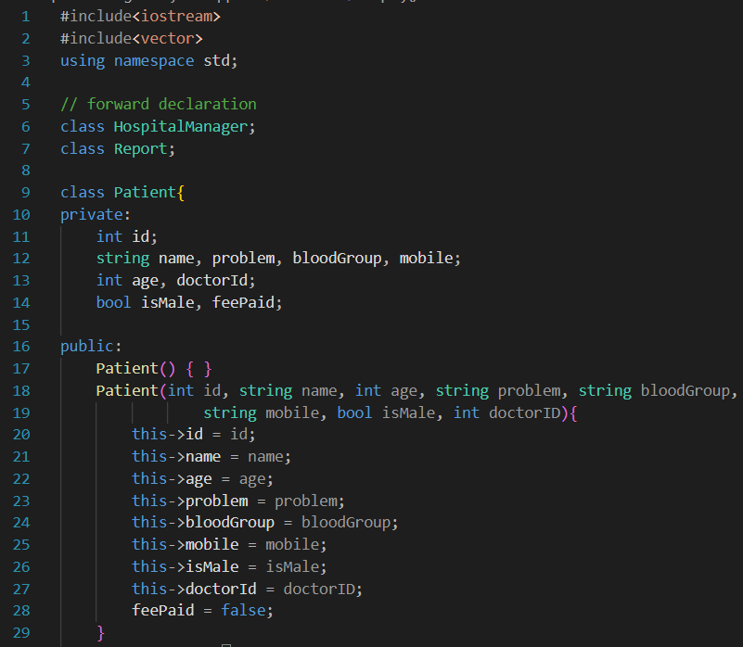
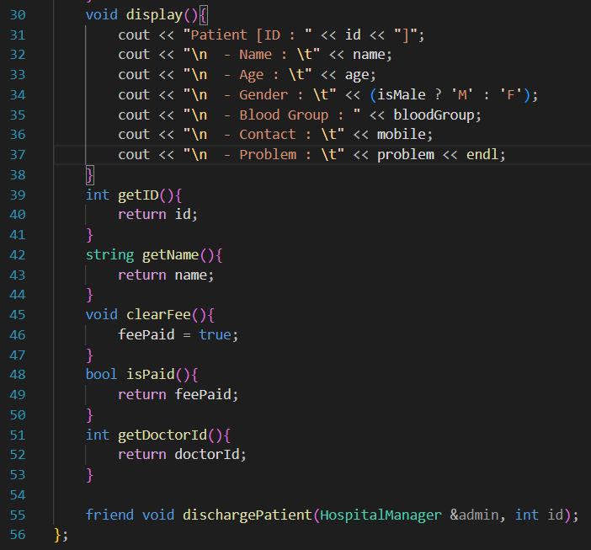
Implementation of MD. Nayeem [2107050]
Patient Class

Slide 5
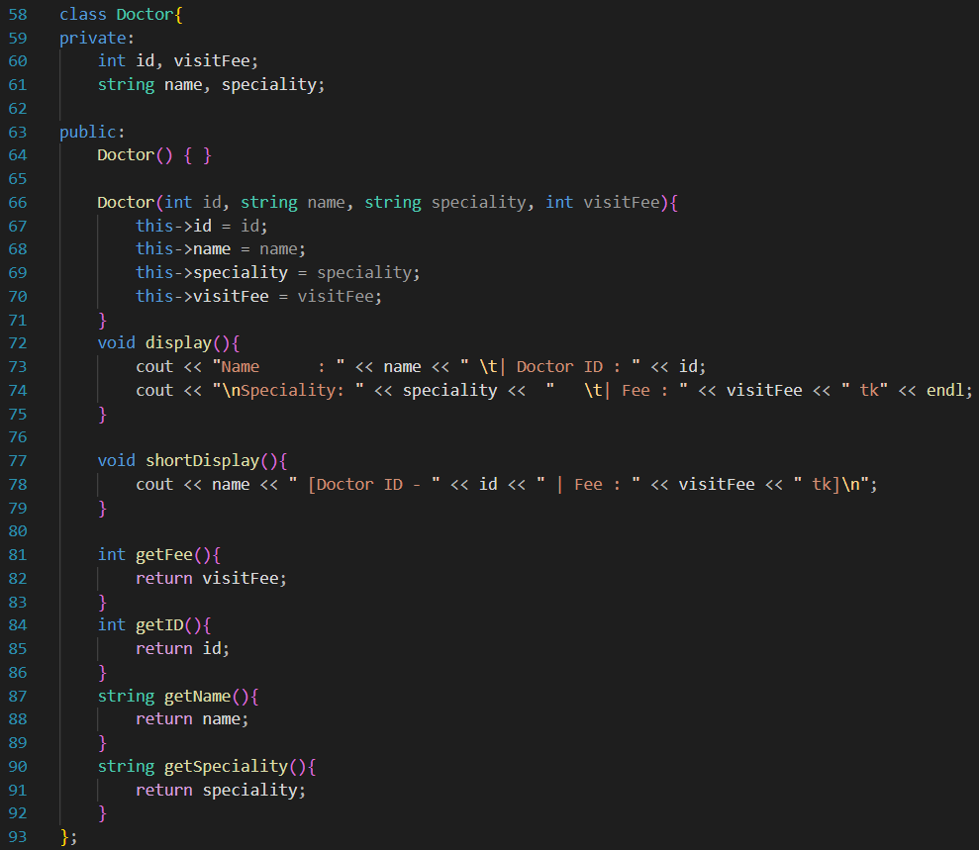
Doctor Class

Slide 6
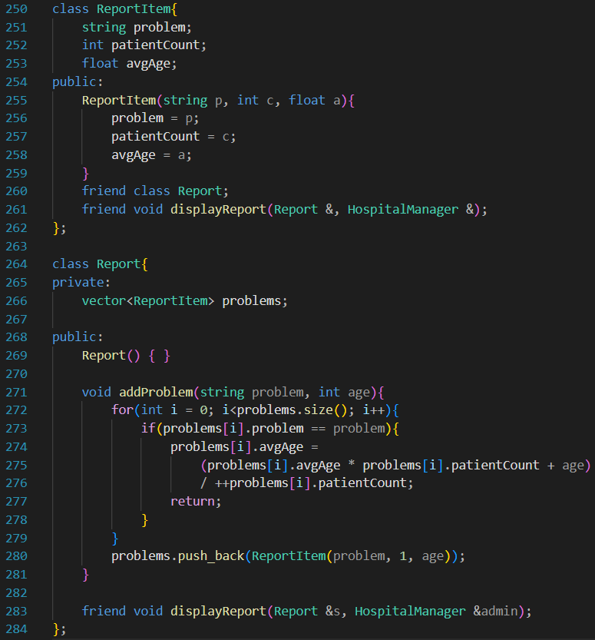
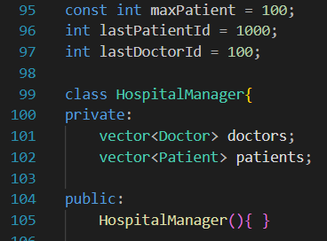
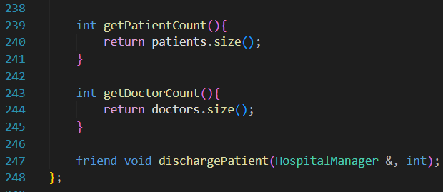
Report &
Report Item Class
Hospital Manager Class
All the member functions and their definition will be provided with the Output

Slide 7
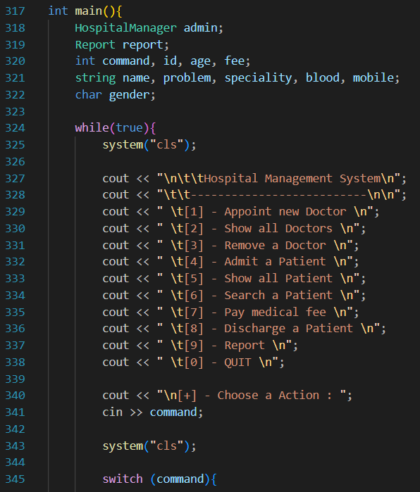
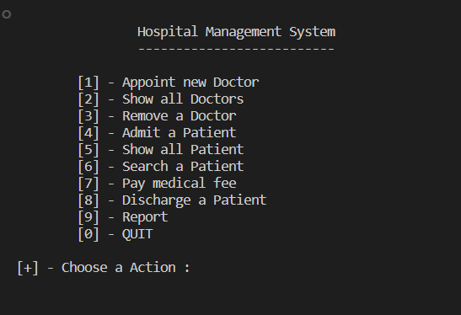
Main Function
Program Output

Slide 8
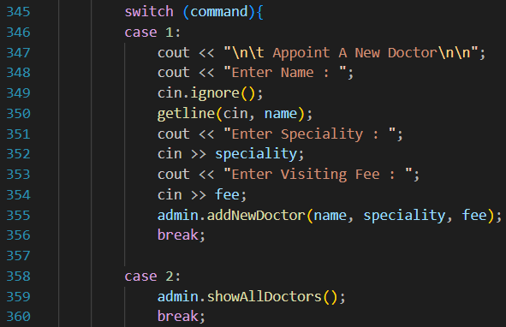
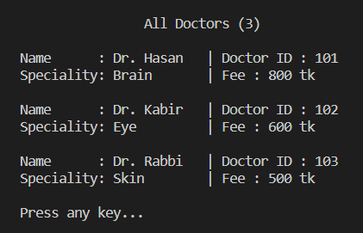
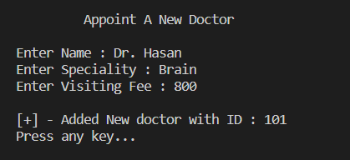
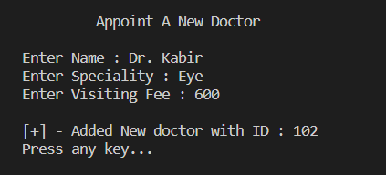
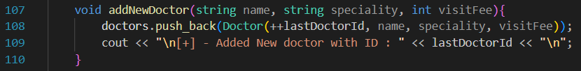
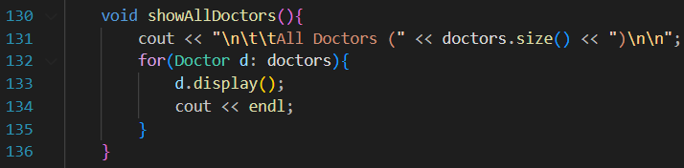
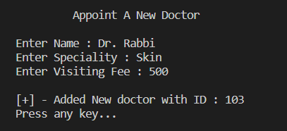
Appoint a New Doctor
Display All Doctors
Output
Output
Functions from HospitalManager Class

Slide 9
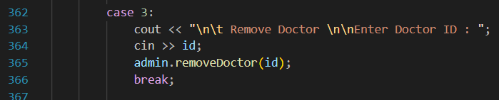
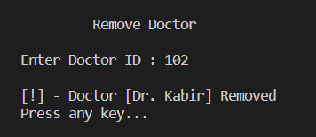
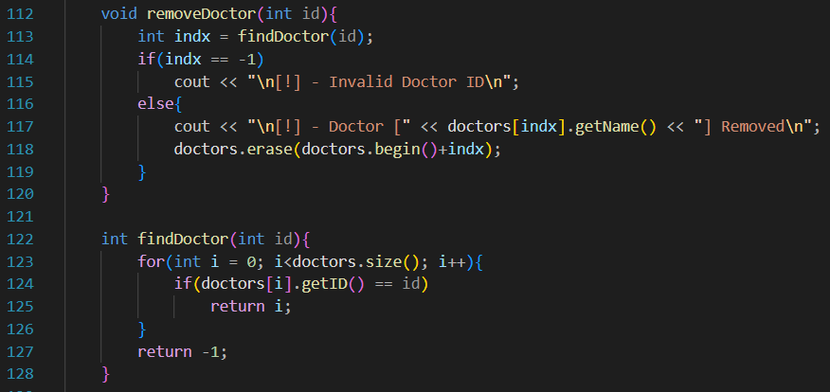
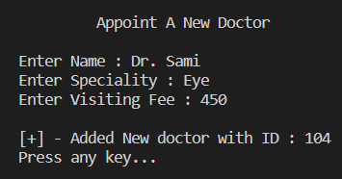
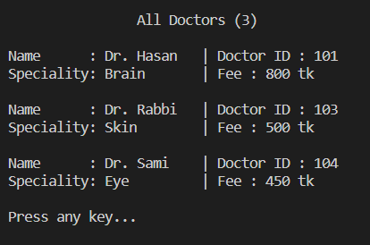
3. Remove a Doctor
Output
Function from HospitalManager Class

Slide 10
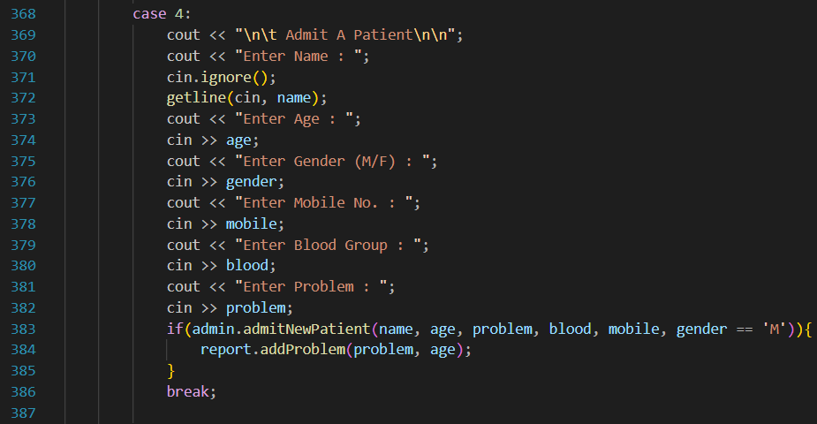
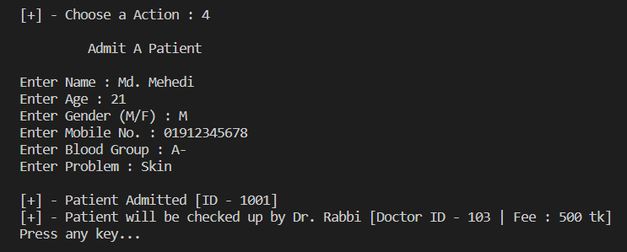
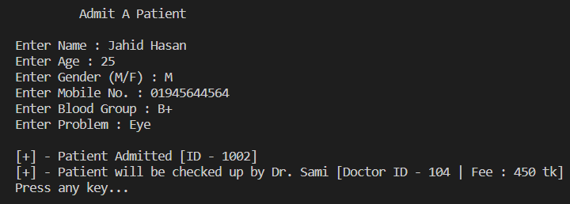
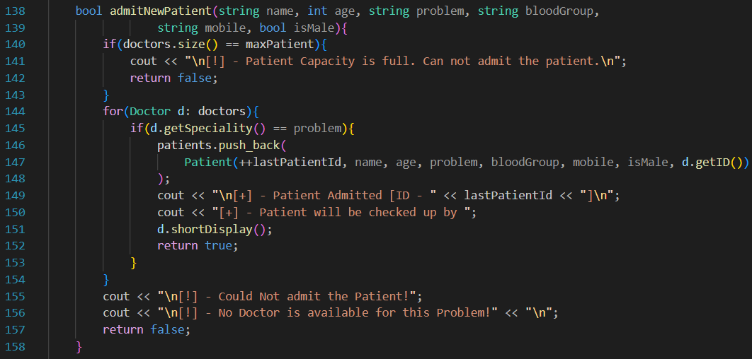
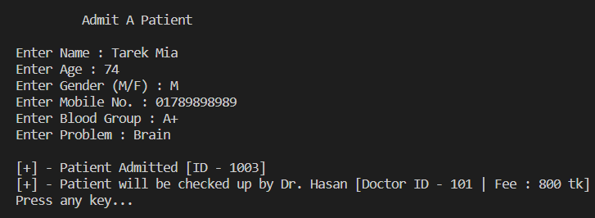
4. Admit A Patient
Output
Function from HospitalManager Class

Slide 11
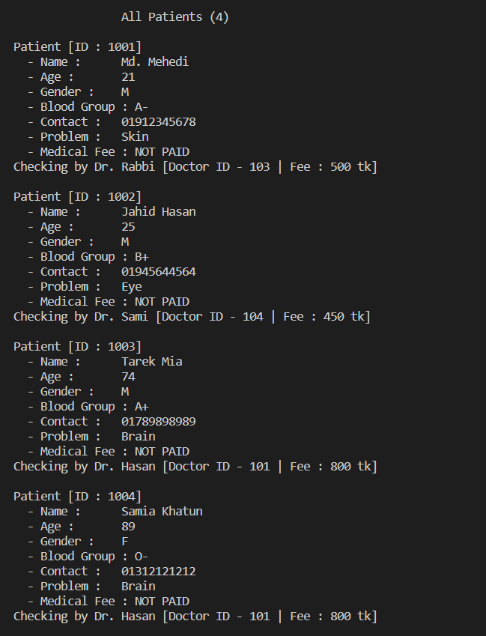
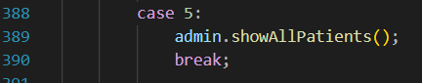
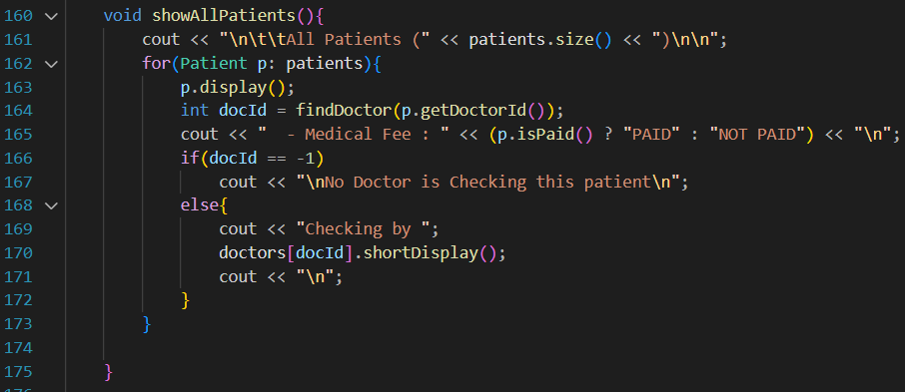
Output
5. Show List of Patients
Function from HospitalManager Class

Slide 12
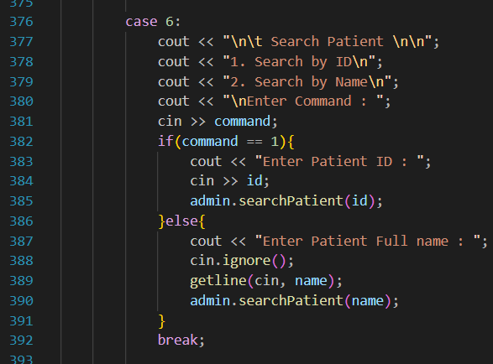
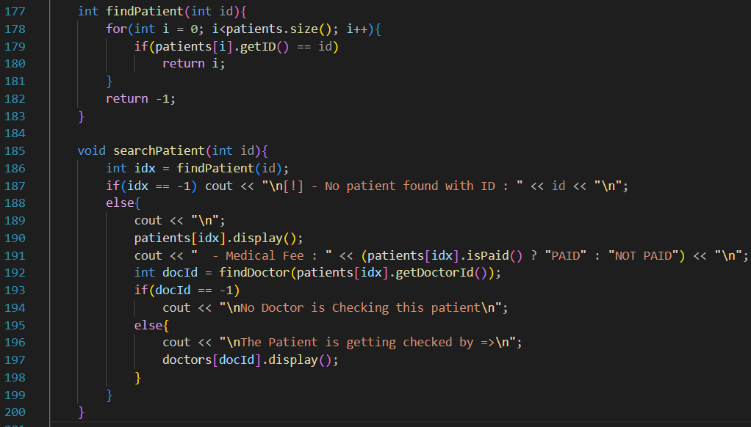
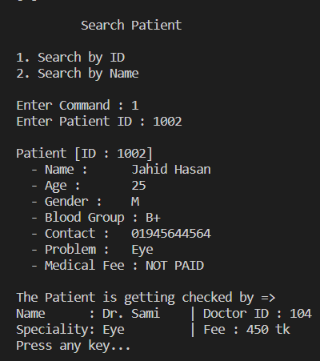
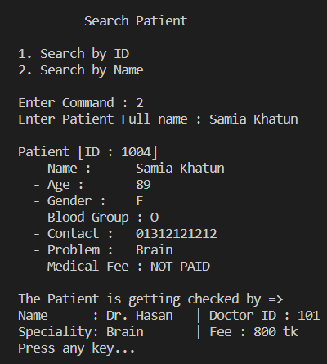
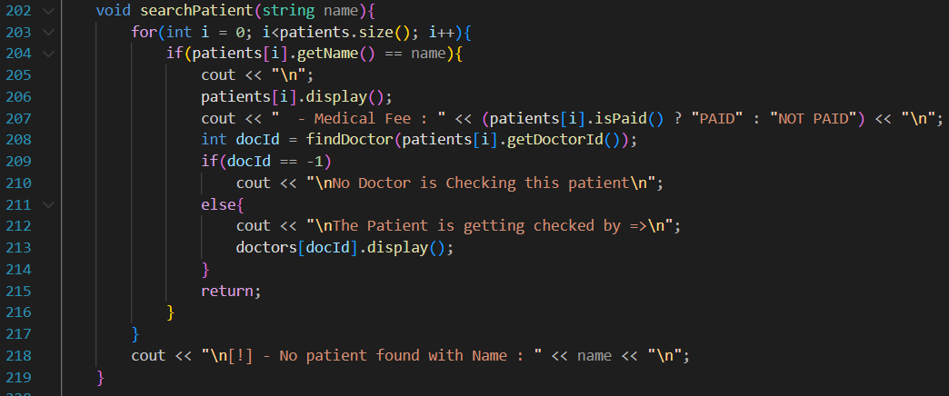
6. Search A Patient by ID/Name
Output

Slide 13
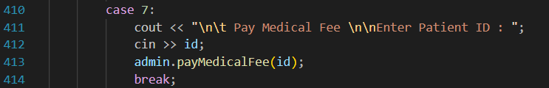
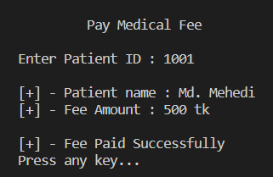
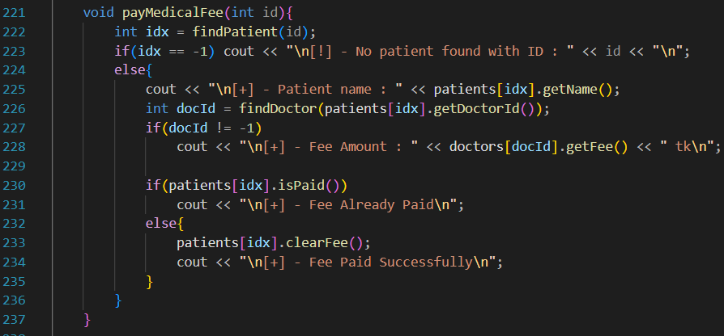
7. Pay Medical Fee
Output
Function from HospitalManager Class

Slide 14
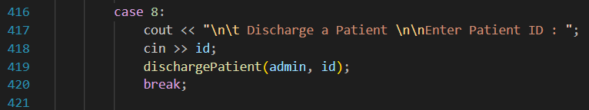
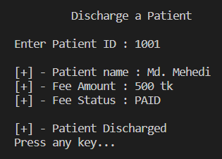
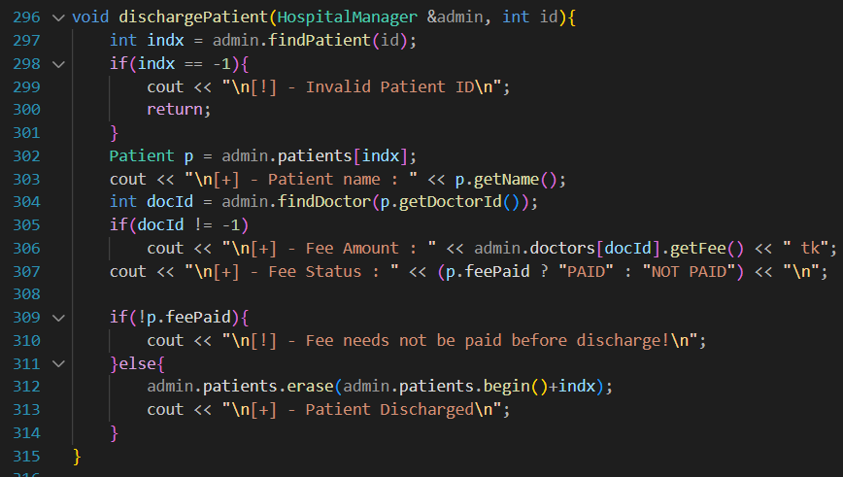
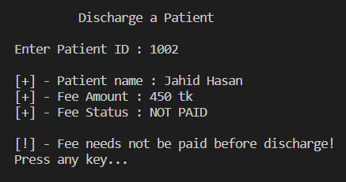
Output
8. Discharge A Patient
Friend Function of HospitalManager & Patient Class

Slide 15
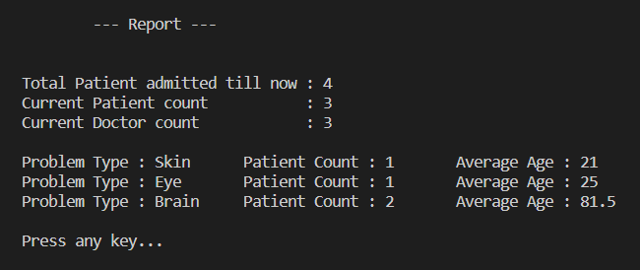
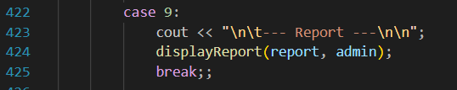
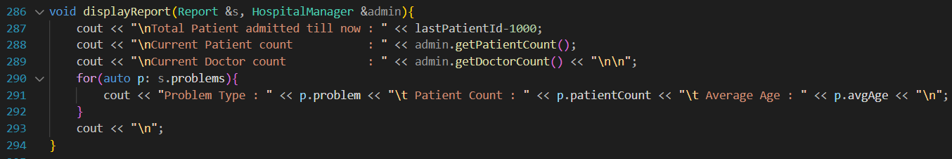
Output
9. Report on Problem Type and Age
Friend Function of Report Class

Slide 16
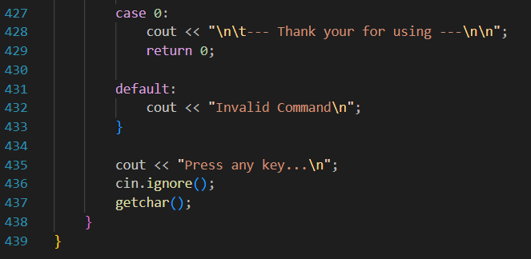

END of Md. Nayeem’s Code
Exit the Program
Output

Slide 17
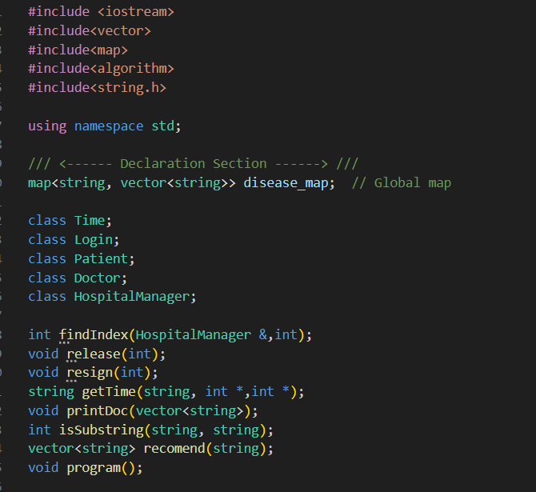
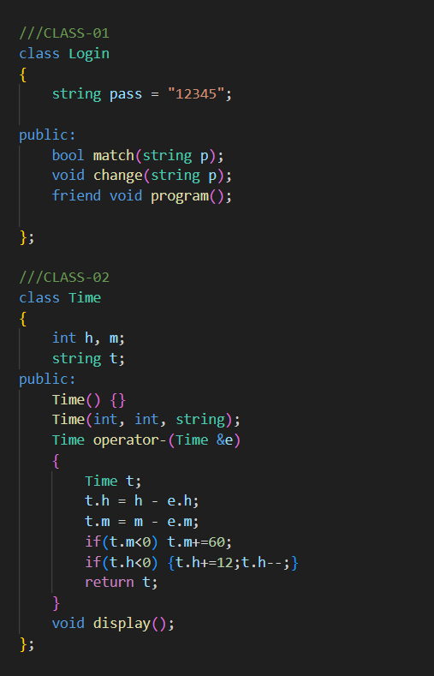
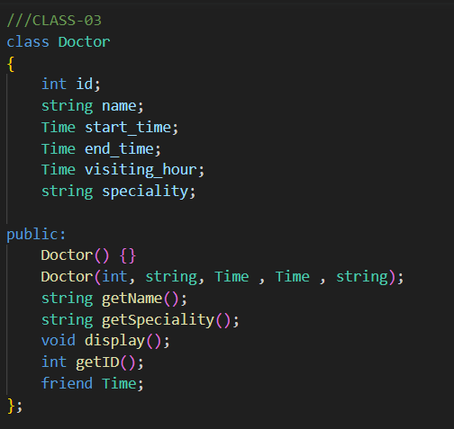
Implementation of Md. Abu Hasanat Soykot [21070100]
Login, Time, Doctor Classes & Function Prototypes

Slide 18
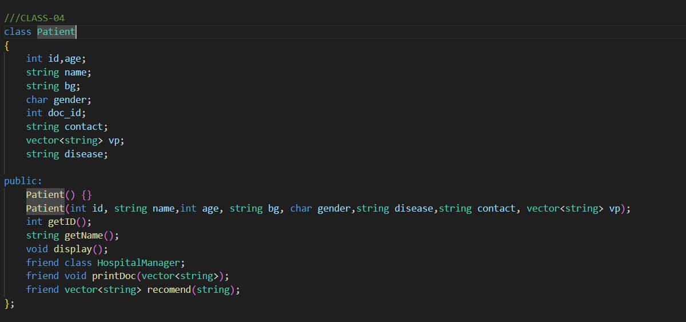
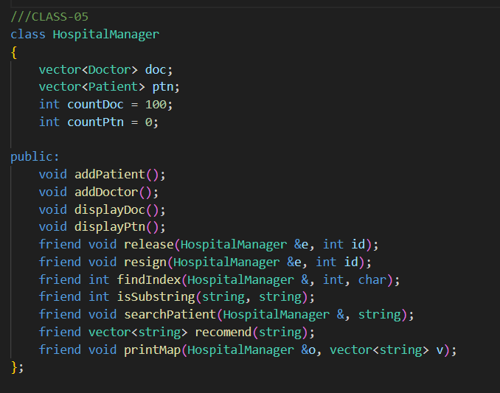
Patient, HospitalManager Classes & Function Prototypes

Slide 19
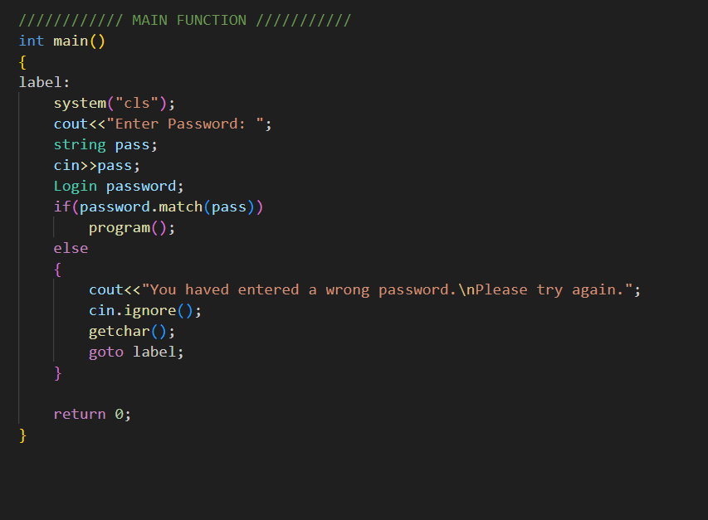



Main Function
Program Output

Slide 20


Main Program
Program Output

Slide 21



Functionalities of Program

Slide 22


Appoint A Doctor

Slide 23


Admit A Patient

Slide 24



Details Of Doctors and Patients

Slide 25



Search Doctor

Slide 26



Search Patient

Slide 27



Release Patient & Resign Doctor

Slide 28

Change Password

Slide 29


END of Md. Abu Hasanat Soykot’s Code
Exit the Program

Slide 30


Implementation of Md. Rubayet Nabil [21070073]
Access & Doctor Class

Slide 31



Patient Class & Hospital Manager Class

Slide 32



Main Program Loop

Slide 33

Adding A Doctor

Slide 34


Adding A Patient

Slide 35




Display all Doctors & Patients

Slide 36




Search Doctors

Slide 37





Search Patient with Name

Slide 38



Search Patient with Contact

Slide 39

END of Md. Rubayet Nabil’S Code
Exit the Program

Slide 40
Thank You

